Slide 1

MX2020 Big Data
Data Leke Reference Architecture
Deequ
Junio 02, 2020

Slide 2
Change control
Versión | Fecha | Descripción del Cambio | Autor/Departamento
0.1 | 01/06/2020 | Creation of the document | [Big Data Architecture] Susana Edith Barrientos Galicia
0.2 | 03/06/2020 | CommadHadoop and CommonLog internal structure diagrams are integrated | Big Data Architecture] Susana Edith Barrientos Galicia
0.3 | 06/06/2020 | HBase model is integrated | Big Data Architecture] Susana Edith Barrientos Galicia
0.4 | 09/06/2020 | The Hive model is integrated | Big Data Architecture] Susana Edith Barrientos Galicia
0.5 | 14/06/2020 | General diagram of packages are integrated and a first version of the class diagram of the analyzer module is incorporated | Big Data Architecture] Susana Edith Barrientos Galicia

Slide 3
Table of Contents
Features and terminology
Needs and Solution Proposal
Graphic Representation of the Solution
Infrastructure and Connectivity
General services
Risks and Dependencies
Standards, Patterns and Decisions of Architecture
References and Annexes

Slide 4
Features and terminology

Slide 5



Features and terminology (I)
Data Lake - Deequ
Data Sources
Acquisition & Ingest layer
Processing Layer
Engine-Ingest
Raw
Curated
Augmented
Layers of Architecture of a Data Lake
Batch Layer
N... node
Functional division for the data life cycle
Hue
Hue
Sentry, Kerberos
UI Framework
SDK
Workflow
Workflow
Hive
Oozie
Scheduler
Metadata
Languages, Compilers
Fast read / write access
Flume, Sqoop
Pig / Hive
HBase
Data Integration
Components of the batch layer
HDFS
Hadoop Distributed File Systems
Job
Spark
Processing
YARN
Resources Manager
Zookeeper
Coordination
cloudera
Data Lake

Slide 6
Needs and Solution Proposal (I)
Descripción de la solución técnica I
Objective
Define the Dquee component architecture, in order to at least meet the following non-functional requirements:
Reusability
Maintainability
Scalability
Ease of Testing
performance
Scope
Graphically represent all architectural views for the Dquee component
Description
Apply the following data quality dimensions to the Data Lake
ApproxQuantile: Approximate quantile of a distribution.
ApproxQuantiles: Approximate quantiles of a distribution.
Completeness: Fraction of non-null values in a column.
Compliance: Fraction of rows that comply with the given column constraint.
Correlation: Pearson correlation coefficient, measures the linear correlation between two columns.
CountDistinct: Number of distinct values.
DataType: Distribution of data types such as Boolean, Fractional, Integral, and String.

Slide 7
Needs and Solution Proposal (I)
Descripción de la solución técnica II
Description -
Apply the following data quality dimensions to the Data Lake
Distinctness: Fraction of distinct values of a column over the number of all values of a column.
Entropy: Entropy is a measure of the level of information contained in an event (value in a column) when considering all possible events (values in a column). It is measured in nats (natural units of information).
Maximum: Maximum value.
Minimum: Minimum value.
MutualInformation: Mutual information describes how much information about one column (one random variable) can be inferred from another column (another random variable).
Size: Number of rows
Sum: Sum of all values of a column.
UniqueValueRatio: Fraction of unique values over the number of all distinct values of a column. Unique values occur exactly once; distinct values occur at least once.
Uniqueness: Fraction of unique values over the number of all values of a column.

Slide 8

Needs and Solution Proposal (II)
New component
Component to modify
Data Lake - Deequ – Global Architecture I
Component not contemplated
General flow
Data Sources
Serving Layer
Integration with Hadoop components
Acquisition & Ingest layer
Processing Layer
A
B
Engine-Ingest
Raw
Curated
Augmented
1.
Visualization Tool
Pendiente
4.
Batch Layer
N... node
Hue
Hue
Sentry, Kerberos
UI Framework
SDK
Workflow
Workflow
Hive
Oozie
Scheduler
Metadata
Languages, Compilers
Fast read / write access
Flume, Sqoop
Pig / Hive
HBase
Data Integration
A
2.
HDFS
Hadoop Distributed File Systems
B
Job
Spark
Processing
3.
YARN
Resources Manager
Zookeeper
Coordination
cloudera

Slide 9
Needs and Solution Proposal (III)
New component
Component to modify
Data Lake - Deequ – Global Architecture I
Module not considered in a first phase
General flow
Data Quality Constraints
5.
Data Quality Report
Metric calculation: Deequ calculates data quality metrics, that is, statistics such as integrity, maximum or correlation. Deequ uses Spark to read sources (HDFS, Hive, Impala, etc.) and to calculate metrics through an optimized set of aggregation queries. You have direct access to the raw metrics calculated in the data.
Constraint verification: The component is intended to allow choosing data quality constraints according to projects (the component is prepared to use automated constraint suggestion methods that profile the data to infer useful constraints.
Constraint Suggestion: Allows you to choose data quality constraints according to projects (component is prepared to use automated constraint hint methods that profile data to infer useful constraints)
Deequ
3.
Constraint Suggestion
2.
Constraint
Verification
Data
4.
Metrics
Apache Spark
Metric calculation
1.
4.
Client Component

Slide 10
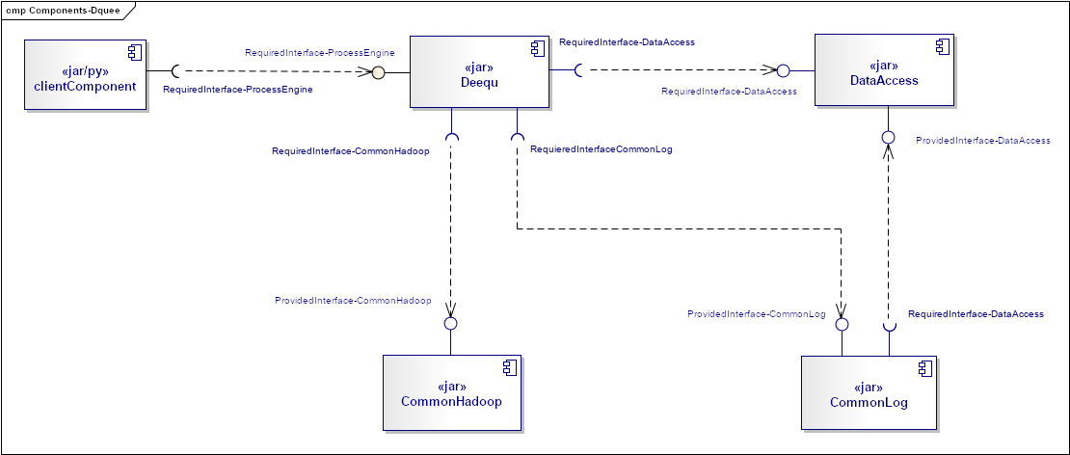
Needs and Solution Proposal (III)
New component
Component to modify
Data Lake - Deequ – Global Architecture I
Module not considered in a first phase
General flow

Slide 11
Needs and Solution Proposal (IV)
Data Lake - Deequ – Use Case View II
Pending

Slide 12
Needs and Solution Proposal (V)
Data Lake - Deequ – Model Report Metrics Hbase I
{
fdc-000000001 :
{
Source: {
System:{timestamp1: "FraudControl"}
Type:{timestamp1: "File"}
FileName:{timestamp1: "SomeName"}
FileHeaderDefinition:{timestamp1: "dsdepto,dsgotrab,dstitdem"}
DelimiterType:{timestamp1: "Pendiente"}
DataBaseName:{timestamp1: "SomeBaseName"}
TableName:{timestamp1: "SomeTableName"}
RawPath:{timestamp1: "SomePathGoldenCopy"}
GoldenCopy:{timestamp1: "SomePathRaw"}
CompressionFormat:{timestamp1: "Snappy"}
ColumKey:{timestamp1: "SomeColumnKey"}
SecondColumKey:{timestamp1: "SomeSecondColumnKey"}
Frecuency:{timestamp1: "Daily"}
RowCont:{timestamp1: "12896"}
ColumnCount:{timestamp1: "895"}
CheckSum:{timestamp1: "268435"}
DataTypeValidation:{timestamp1: "int,char,date,int,double"}
IngestionStatus:{timestamp1: "0"}
ProcessDate:{timestamp1: "2020-06-02 5:51:26 PM"}
idStep:{timestamp1: "log-000000001"}
}
Target: {
Type:{timestamp1: "Hbase-Hive"}
DataBaseName:{timestamp1: "FraudControl"}
TableName:{timestamp1: "SomeTableName"}
CuratedPath:{timestamp1: "SomeName"}
RowCont:{timestamp1: "12896"}
ColumnCount:{timestamp1: "895"}
CheckSum:{timestamp1: "268435"}
DataTypeValidation:{timestamp1: "dsdepto,dsgotrab,dstitdem"}
TargetStatus:{timestamp1: "SomePathRaw"}
ProcessDate:{timestamp1: "2020-06-02 6:05:26 PM"}
}
Metrics: {
ColumCountStatus:{timestamp1: "0"}
ColumValidationStatus:{timestamp1: "0"}
CheckSumStatus:{timestamp1: "0"}
DataTypeValidationStatus:{timestamp1: "0"}
FileCheckStatus:{timestamp1: "0"}
RowCountStatus:{timestamp1: "0"}
DifferentColumns:{timestamp1: "dsdepto,dsgotrab,dstitdem"}
TotalMismatchCheckSum:{timestamp1: "1"}
TotalMismachRaws:{timestamp1: "2"}
TotalMismachColumns:{timestamp1: "2"}
DescriptionStatus: {timestamp1: "SomeDescription"}
}
}
}c
Logical Model
 | Source
RowKey | Column_Family (Source)
Source + Random UUID | Column Source: System
 | Column Source: Type
 | Column Source: FileName
 | Column Source: FileHeaderDefinition
 | Column Source: DataBaseName
 | Column Source: TableName
 | Column Source: RawPath
 | Column Source: GoldenCopy
 | Column Source: CompressionFormat
 | Column Source: ColumKey
 | Column Source: SecondColumKey
 | Column Source: Frecuency
 | Column Source: RowCont
 | Column Source: ColumnCount
 | Column Source: CheckSum
 | Column Source: DataTypeValidation
 | Column Source: IngestionStatus
 | Column Source: ProcessDate
 | Column Source: idStep
 | Source
RowKey | System | Type | FileName | FileHeaderDefinition | DataBaseName | TableName | GoldenCopy | RawPath | CompressionFormat | ColumnKey | SecondColumnKey | Frecuency | RowCont | ColumnCount | CheckSum | DataTypeValidation | IngestionStatus | ProcessDate | idStep
fdc-000000001 | FraudControl | File | SomeName | dsdepto,dsgotrab,dstitdem | SomeBaseName | SomeTableName | SomePathGoldenCopy | SomePathRaw | Snappy | SomeColumnKey | SomeSecondColumnKey | Daily | 12896 | 895 | 268435 | 0 | 0 | 6/2/20 17:51 | log-00000001

Slide 13
Needs and Solution Proposal (VI)
Data Lake - Deequ – Data Model Metrics Hbase II
{
fdc-000000001 :
{
Source: {
System:{timestamp1: "FraudControl"}
Type:{timestamp1: "File"}
FileName:{timestamp1: "SomeName"}
FileHeaderDefinition:{timestamp1: "dsdepto,dsgotrab,dstitdem"}
DelimiterType:{timestamp1: "Pendiente"}
DataBaseName:{timestamp1: "SomeBaseName"}
TableName:{timestamp1: "SomeTableName"}
RawPath:{timestamp1: "SomePathGoldenCopy"}
GoldenCopy:{timestamp1: "SomePathRaw"}
CompressionFormat:{timestamp1: "Snappy"}
ColumKey:{timestamp1: "SomeColumnKey"}
SecondColumKey:{timestamp1: "SomeSecondColumnKey"}
Frecuency:{timestamp1: "Daily"}
RowCont:{timestamp1: "12896"}
ColumnCount:{timestamp1: "895"}
CheckSum:{timestamp1: "268435"}
DataTypeValidation:{timestamp1: "int,char,date,int,double"}
IngestionStatus:{timestamp1: "0"}
ProcessDate:{timestamp1: "2020-06-02 5:51:26 PM"}
idStep:{timestamp1: "log-000000001"}
}
Target: {
Type:{timestamp1: "Hbase-Hive"}
DataBaseName:{timestamp1: "FraudControl"}
TableName:{timestamp1: "SomeTableName"}
CuratedPath:{timestamp1: "SomeName"}
RowCont:{timestamp1: "12896"}
ColumnCount:{timestamp1: "895"}
CheckSum:{timestamp1: "268435"}
DataTypeValidation:{timestamp1: "dsdepto,dsgotrab,dstitdem"}
TargetStatus:{timestamp1: "SomePathRaw"}
ProcessDate:{timestamp1: "2020-06-02 6:05:26 PM"}
}
Metrics: {
ColumCountStatus:{timestamp1: "0"}
ColumValidationStatus:{timestamp1: "0"}
CheckSumStatus:{timestamp1: "0"}
DataTypeValidationStatus:{timestamp1: "0"}
FileCheckStatus:{timestamp1: "0"}
RowCountStatus:{timestamp1: "0"}
DifferentColumns:{timestamp1: "dsdepto,dsgotrab,dstitdem"}
TotalMismatchCheckSum:{timestamp1: "1"}
TotalMismachRaws:{timestamp1: "2"}
TotalMismachColumns:{timestamp1: "2"}
DescriptionStatus: {timestamp1: "SomeDescription"}
}
}
}
Logical Model
 | Target
RowKey | Column_Family (Source)
Source + Random UUID | Column Target: Type
 | Column Target: DataBaseName
 | Column Target: TableName
 | Column Target: CuratedPath
 | Column Target: RowCont
 | Column Target: ColumnCount
 | Column Target: CheckSum
 | Column Target: DataTypeValidation
 | Column Target: TargetStatus
 | Column Target: ProcessDate
 | Target
RowKey | Type | DataBaseName | TableName | TargetPath | RowCont | ColumnCount | CheckSum | DataTypeValidation | TargetStatus | ProcessDate
fdc-000000001 | Hbase-Hive | FraudControl | SomeTableName | SomeTargetPath | 12896 | 895 | 268435 | dsdepto,dsgotrab,dstitdem | SomePathRaw | 6/2/20 18:05

Slide 14
Needs and Solution Proposal (VII)
Data Lake - Deequ – Data Model Metrics Hbase II
{
fdc-000000001 :
{
Source: {
System:{timestamp1: "FraudControl"}
Type:{timestamp1: "File"}
FileName:{timestamp1: "SomeName"}
FileHeaderDefinition:{timestamp1: "dsdepto,dsgotrab,dstitdem"}
DelimiterType:{timestamp1: "Pendiente"}
DataBaseName:{timestamp1: "SomeBaseName"}
TableName:{timestamp1: "SomeTableName"}
RawPath:{timestamp1: "SomePathGoldenCopy"}
GoldenCopy:{timestamp1: "SomePathRaw"}
CompressionFormat:{timestamp1: "Snappy"}
ColumKey:{timestamp1: "SomeColumnKey"}
SecondColumKey:{timestamp1: "SomeSecondColumnKey"}
Frecuency:{timestamp1: "Daily"}
RowCont:{timestamp1: "12896"}
ColumnCount:{timestamp1: "895"}
CheckSum:{timestamp1: "268435"}
DataTypeValidation:{timestamp1: "int,char,date,int,double"}
IngestionStatus:{timestamp1: "0"}
ProcessDate:{timestamp1: "2020-06-02 5:51:26 PM"}
idStep:{timestamp1: "log-000000001"}
}
Target: {
Type:{timestamp1: "Hbase-Hive"}
DataBaseName:{timestamp1: "FraudControl"}
TableName:{timestamp1: "SomeTableName"}
CuratedPath:{timestamp1: "SomeName"}
RowCont:{timestamp1: "12896"}
ColumnCount:{timestamp1: "895"}
CheckSum:{timestamp1: "268435"}
DataTypeValidation:{timestamp1: "dsdepto,dsgotrab,dstitdem"}
TargetStatus:{timestamp1: "SomePathRaw"}
ProcessDate:{timestamp1: "2020-06-02 6:05:26 PM"}
}
Metrics: {
ColumCountStatus:{timestamp1: "0"}
ColumValidationStatus:{timestamp1: "0"}
CheckSumStatus:{timestamp1: "0"}
DataTypeValidationStatus:{timestamp1: "0"}
FileCheckStatus:{timestamp1: "0"}
RowCountStatus:{timestamp1: "0"}
DifferentColumns:{timestamp1: "dsdepto,dsgotrab,dstitdem"}
TotalMismatchCheckSum:{timestamp1: "1"}
TotalMismachRaws:{timestamp1: "2"}
TotalMismachColumns:{timestamp1: "2"}
DescriptionStatus: {timestamp1: "SomeDescription"}
}
}
}
Logical Model
 | Metrics
RowKey | Column_Family (Source)
Source + Random UUID | Column Metrics: ColumCountStatus
 | Column Metrics: ColumValidationStatus
 | Column Metrics: CheckSumStatus
 | Column Metrics: DataTypeValidationStatus
 | Column Metrics: FileCheckStatus
 | Column Metrics: RowCountStatus
 | Column Metrics: DifferentColumns
 | Column Metrics: TotalMismatchCheckSum
 | Column Metrics: TotalMismachRaws
 | Column Metrics: TotalMismachColumns
 | Column Metrics: DescriptionStatus
 | Metrics
RowKey | ColumCountStatus | ColumValidationStatus | CheckSumStatus | DataTypeValidationStatus | FileCheckStatus | RowCountStatus | DifferentColumns | TotalMismatchCheckSum | TotalMismachRaws | TotalMismachColumns
fdc-000000001 | 0 | 0 | 0 | 0 | 0 | 0 | 2 | 2 | 2 | 2

Slide 15
Needs and Solution Proposal (VIII)
Data Lake - Deequ – Data Model Metrics Hive I
Table
DeequeReport
Partition…n
Partition 1
Partition 2
Bucket 1
ProcessDate
Bucket… n
ProcessDate
Bucket… n
Bucket 2c
Bucket 3
*
Bucket 1
Bucket 2
Bucket 1
Bucket 2
Bucket 1
Bucket 2
Bucket 1
Bucket 2
System
*
*
*
*
*
*
*
ScType
System
System
System
System
System
System
System
ScFileName
ScType
ScType
ScType
ScType
ScType
ScType
ScType
ScFileHeaderDefinition
ScFileName
ScFileName
ScFileName
ScFileName
ScFileName
ScFileName
ScFileName
ScDelimiterType
ScFileHeaderDefinition
ScFileHeaderDefinition
ScFileHeaderDefinition
ScFileHeaderDefinition
ScFileHeaderDefinition
ScFileHeaderDefinition
ScFileHeaderDefinition
ScDataBaseName
ScDelimiterType
ScDelimiterType
ScDelimiterType
ScDelimiterType
ScDelimiterType
ScDelimiterType
ScDelimiterType
ScTableName
ScDataBaseName
ScDataBaseName
ScDataBaseName
ScDataBaseName
ScDataBaseName
ScDataBaseName
ScDataBaseName
ScRawPath
ScTableName
ScTableName
ScTableName
ScTableName
ScTableName
ScTableName
ScTableName
GoldenCopy
ScRawPath
ScRawPath
ScRawPath
ScRawPath
ScRawPath
ScRawPath
ScRawPath
CompressionFormat
GoldenCopy
GoldenCopy
GoldenCopy
GoldenCopy
GoldenCopy
GoldenCopy
GoldenCopy
ColumKey
CompressionFormat
CompressionFormat
CompressionFormat
CompressionFormat
CompressionFormat
CompressionFormat
CompressionFormat
SecondColumKey
ColumKey
ColumKey
ColumKey
ColumKey
ColumKey
ColumKey
ColumKey
Frecuency
SecondColumKey
SecondColumKey
SecondColumKey
SecondColumKey
SecondColumKey
SecondColumKey
SecondColumKey
ScRowCont
Frecuency
Frecuency
Frecuency
Frecuency
Frecuency
Frecuency
Frecuency
ScColumnCount
ScRowCont
ScRowCont
ScRowCont
ScRowCont
ScRowCont
ScRowCont
ScRowCont
ScCheckSum
ScColumnCount
ScColumnCount
ScColumnCount
ScColumnCount
ScColumnCount
ScColumnCount
ScColumnCount
ScDataTypeValidation
ScCheckSum
ScCheckSum
ScCheckSum
ScCheckSum
ScCheckSum
ScCheckSum
ScCheckSum
IngestionStatus
ScDataTypeValidation
ScDataTypeValidation
ScDataTypeValidation
ScDataTypeValidation
ScDataTypeValidation
ScDataTypeValidation
ScDataTypeValidation
TgType
IngestionStatus
IngestionStatus
IngestionStatus
IngestionStatus
IngestionStatus
IngestionStatus
IngestionStatus
TgDataBaseName
TgType
TgType
TgType
TgType
TgType
TgType
TgType
TgTableName
TgDataBaseName
TgDataBaseName
TgDataBaseName
TgDataBaseName
TgDataBaseName
TgDataBaseName
TgDataBaseName
CuratedPath
TgTableName
TgTableName
TgTableName
TgTableName
TgTableName
TgTableName
TgTableName
TgRowCont
CuratedPath
CuratedPath
CuratedPath
CuratedPath
CuratedPath
CuratedPath
CuratedPath
TgColumnCount
TgRowCont
TgRowCont
TgRowCont
TgRowCont
TgRowCont
TgRowCont
TgRowCont
TgCheckSum
TgColumnCount
TgColumnCount
TgColumnCount
TgColumnCount
TgColumnCount
TgColumnCount
TgColumnCount
TgDataTypeValidation
TgCheckSum
TgCheckSum
TgCheckSum
TgCheckSum
TgCheckSum
TgCheckSum
TgCheckSum
TgStatus
TgDataTypeValidation
TgDataTypeValidation
TgDataTypeValidation
TgDataTypeValidation
TgDataTypeValidation
TgDataTypeValidation
TgDataTypeValidation
TgProcessDate
TgStatus
TgStatus
TgStatus
TgStatus
TgStatus
TgStatus
TgStatus
ColumCountStatus
TgProcessDate
TgProcessDate
TgProcessDate
TgProcessDate
TgProcessDate
TgProcessDate
TgProcessDate
ColumValidationStatus
ColumCountStatus
ColumCountStatus
ColumCountStatus
ColumCountStatus
ColumCountStatus
ColumCountStatus
ColumCountStatus
CheckSumStatus
ColumValidationStatus
ColumValidationStatus
ColumValidationStatus
ColumValidationStatus
ColumValidationStatus
ColumValidationStatus
ColumValidationStatus
DataTypeValidationStatus
CheckSumStatus
CheckSumStatus
CheckSumStatus
CheckSumStatus
CheckSumStatus
CheckSumStatus
CheckSumStatus
FileCheckStatus
DataTypeValidationStatus
DataTypeValidationStatus
DataTypeValidationStatus
DataTypeValidationStatus
DataTypeValidationStatus
DataTypeValidationStatus
DataTypeValidationStatus
RowCountStatus
FileCheckStatus
FileCheckStatus
FileCheckStatus
FileCheckStatus
FileCheckStatus
FileCheckStatus
FileCheckStatus
DifferentColumns
RowCountStatus
RowCountStatus
RowCountStatus
RowCountStatus
RowCountStatus
RowCountStatus
RowCountStatus
TotalMismatchCheckSum
DifferentColumns
DifferentColumns
DifferentColumns
DifferentColumns
DifferentColumns
DifferentColumns
DifferentColumns
TotalMismachRaws
TotalMismatchCheckSum
TotalMismatchCheckSum
TotalMismatchCheckSum
TotalMismatchCheckSum
TotalMismatchCheckSum
TotalMismatchCheckSum
TotalMismatchCheckSum
TotalMismachColumns
TotalMismachRaws
TotalMismachRaws
TotalMismachRaws
TotalMismachRaws
TotalMismachRaws
TotalMismachRaws
TotalMismachRaws
TotalMismachColumns
TotalMismachColumns
TotalMismachColumns
TotalMismachColumns
TotalMismachColumns
TotalMismachColumns
TotalMismachColumns
TotalMismachColumns
DescriptionStatus
TotalMismachColumns
TotalMismachColumns
TotalMismachColumns
TotalMismachColumns
TotalMismachColumns
TotalMismachColumns
TotalMismachColumns
DescriptionStatus
DescriptionStatus
DescriptionStatus
DescriptionStatus
DescriptionStatus
DescriptionStatus
DescriptionStatus
*

Slide 16
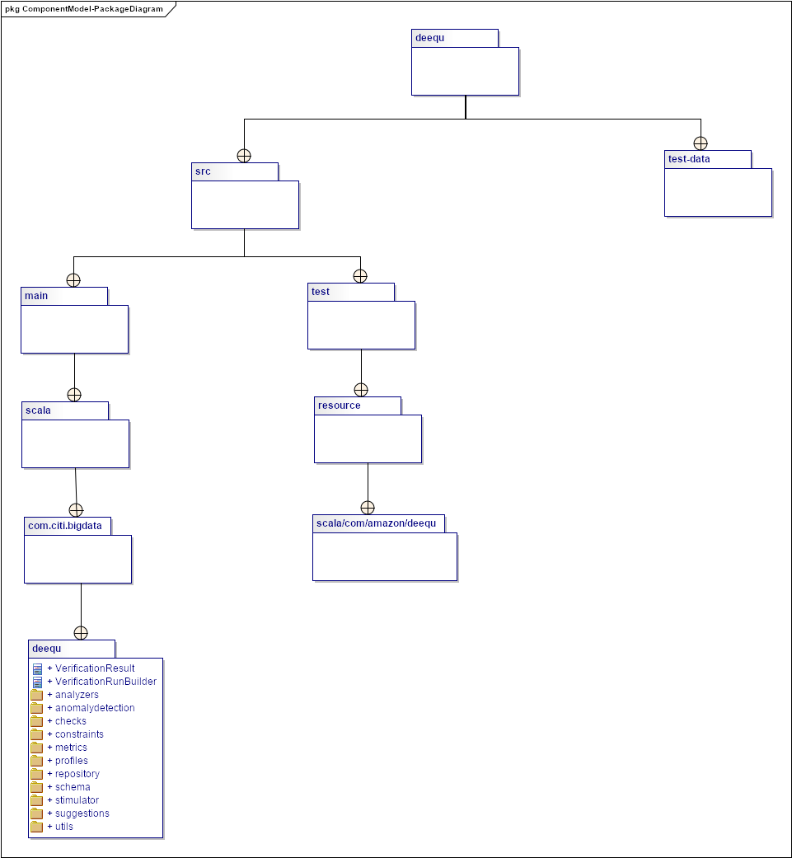
Needs and Solution Proposal (X)
Data Lake - Deequ- Component View I - Package Diagrams

Slide 17
Needs and Solution Proposal (IX)
Data Lake - Deequ – Data Model Metrics Hive II
Pending

Slide 18
Needs and Solution Proposal (XI)
Data Lake - Deequ- Component View II – Utils Class Diagram
Pending

Slide 19
Needs and Solution Proposal (XII)
Data Lake - Deequ- Component View II – runners Class Diagram
Pending

Slide 20
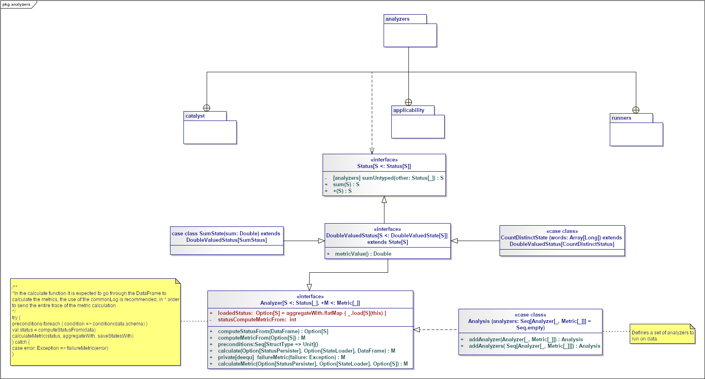
Needs and Solution Proposal (XIII)
Data Lake - Deequ- Component View III - Analyzer Class Diagram

Slide 21
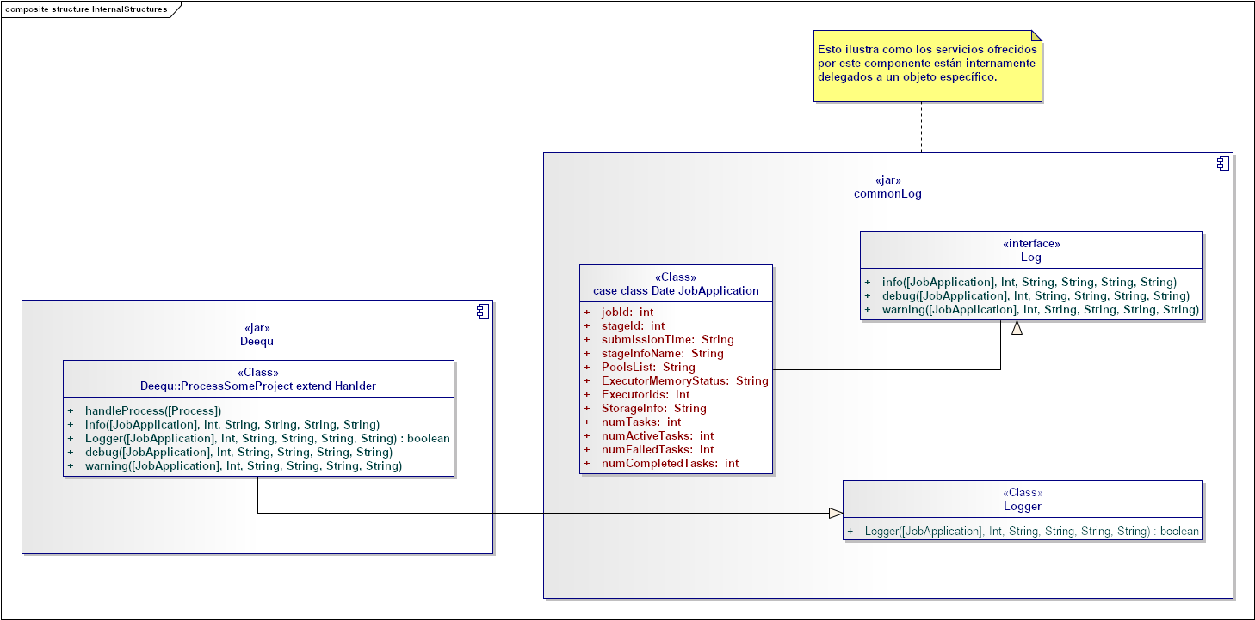
Needs and Solution Proposal (XIV)
Data Lake – Deequ - Component View II – CommonLog Internal structure
The component is designed to scale according to the needs of the projects, it allows decoupling the functionality to record the entire flow of a project. One of its main advantages is that it can be called by different clients, at different points of a certain flow.

Slide 22
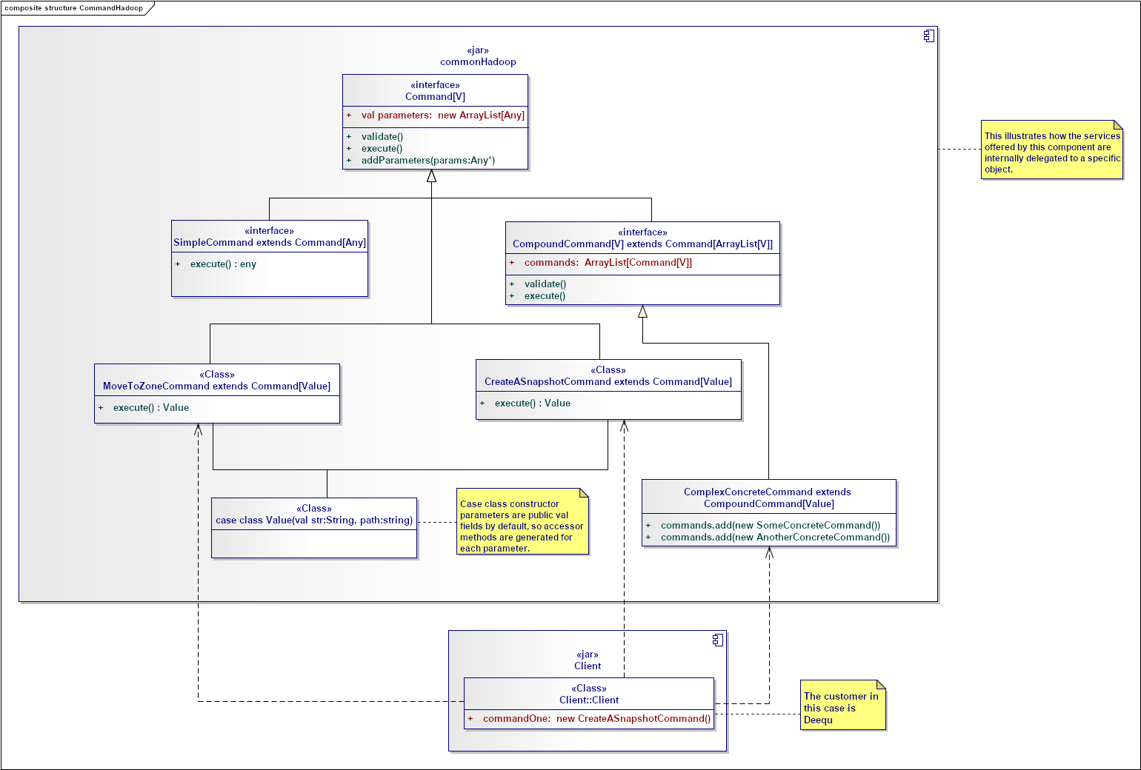
Needs and Solution Proposal (XV)
Data Lake – Deequ - Component View II – CommonHadoop Internal structure
The component is designed to scale according to the needs of the projects, it allows decoupling the functionality to execute Hadoop commands, such as moving to different areas, creating snapshots, deleting files in HDFS, etc. One of its main advantage is that it can be called by different clients, at different points in a flow than different clients.
It is visualized that the Hadoop component moves files to a specific path for the files that have been detected with inconsistencies in the different evaluation metrics of the data quality dimensions

Slide 23
Needs and Solution Proposal (XVI)
Data Lake - Deequ- Component View II - DataAccess Internal structure
Pending

Slide 24
Needs and Solution Proposal (XVII)
Data Lake - Deequ – Deployment view
Pending

Slide 25
Volumetría (I)
Case of use -
Characteristic | Detalle

Slide 26
Servicios Generales (I)
Seguridad
El detalle de los lineamientos mencionados están definidos en los documentos:
Standards for the creation of topics, development and security
Confidencialidad
Communication through mutual authentication and Kerberos between Data Lake
Auditoria:
.

Slide 27
Risks and Dependencies (I)
Coexistence
The detail of the mentioned guidelines are defined
Validate the integration standards with Data Lake, with Data Governance
Risks
El detalle de los lineamientos mencionados están definidos en los documentos:
Concept tests to integrate Kerberos between Data Lake

Slide 28
Risks and Dependencies (II)
Dependencias
El detalle de los lineamientos mencionados están definidos en los documentos:
Standard of Security Controls in Data Lake

Slide 29
Standards, Patterns and Decisions of Architecture (I)
Exceptions to Standards and Architecture Patterns
Pendiene

Slide 30
Standards, Patterns and Decisions of Architecture (II)
Architecture Decisions
Decisión | Premisas | Razonamiento de la Decisión
Pendiente | Pendiente | Pendiente

Slide 31
Standards, Patterns and Decisions of Architecture (III)
Outbuildings
Dependencia | Componente externo a la solución que impacta | Fecha estimada en la que se requiere disponible
Not apply | Not apply | Not apply

Slide 32
References and Annex (I)
References
Nombre y version | Fecha | Comentarios | Rol/Departamento

